Slide 1
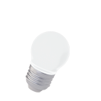
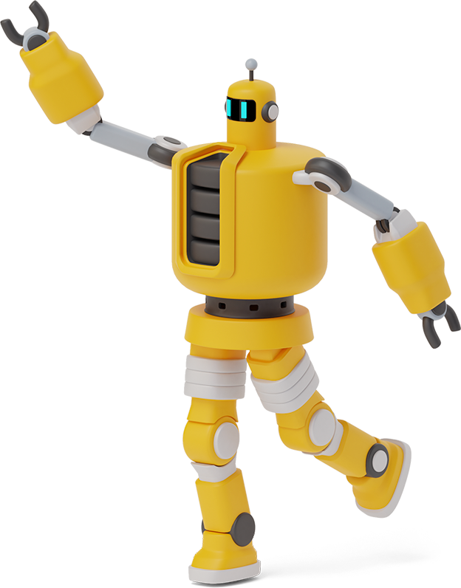
Industrial Control
Projects

Slide 2
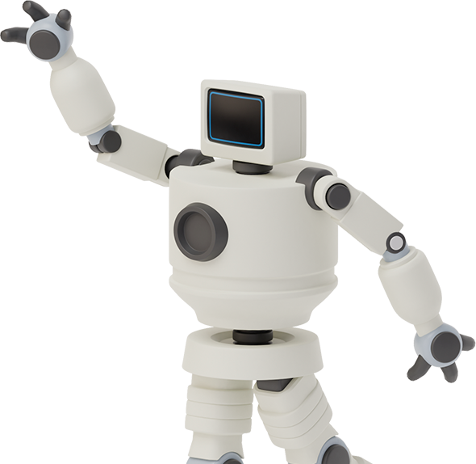

Hello!
Mohammad Barabadi
Mahya Haghgo
Sajad Ghadiri
Maral Mordad

Slide 3

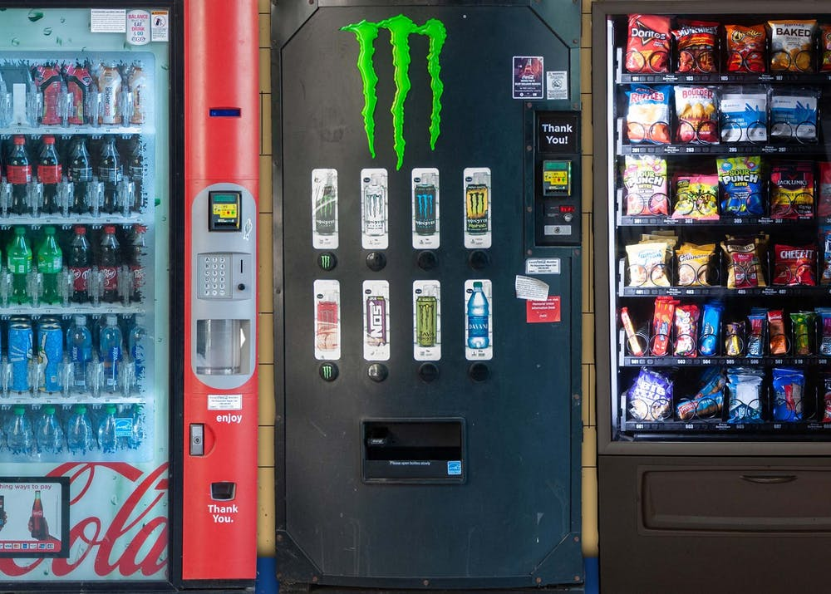
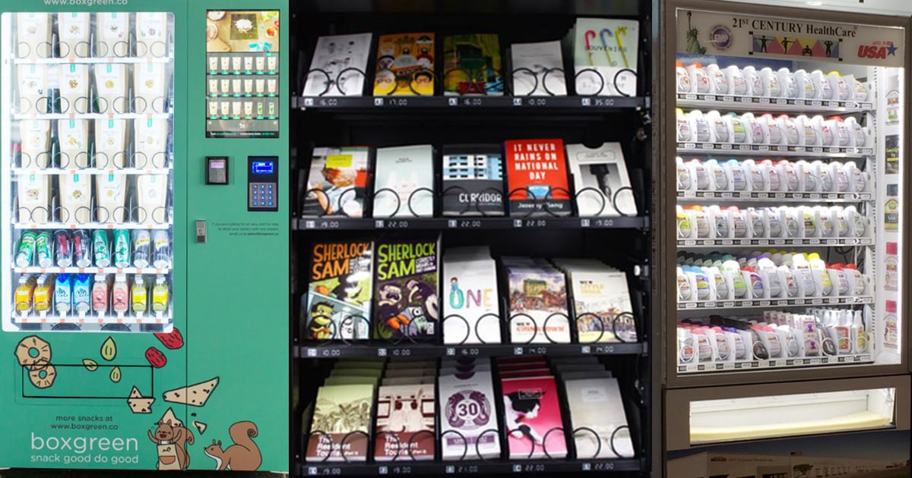
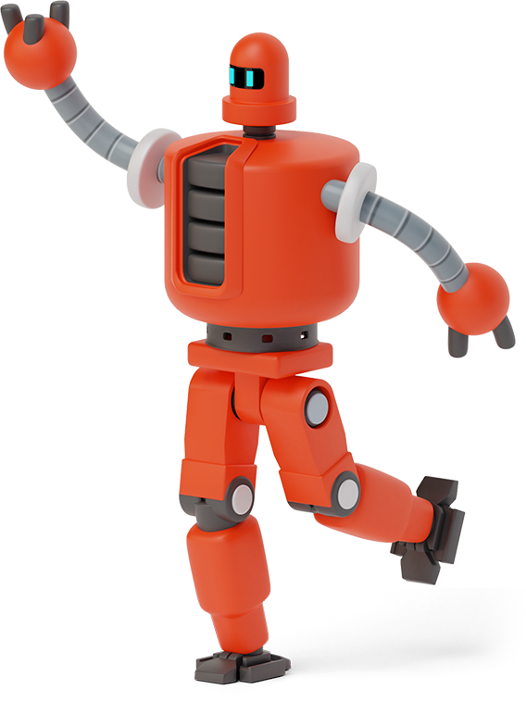
Vending Machine
2
What Is Vending Machine?!?!

Slide 4
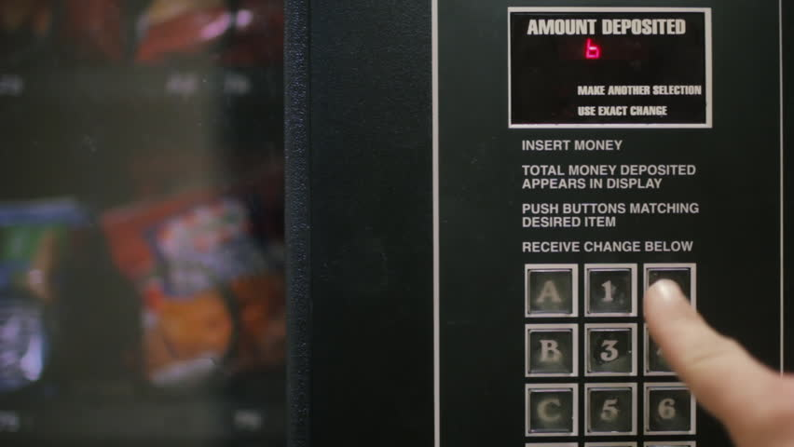
Vending Machine
2
Product Selection

Slide 5
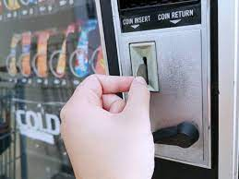
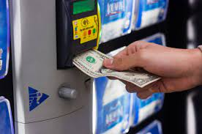
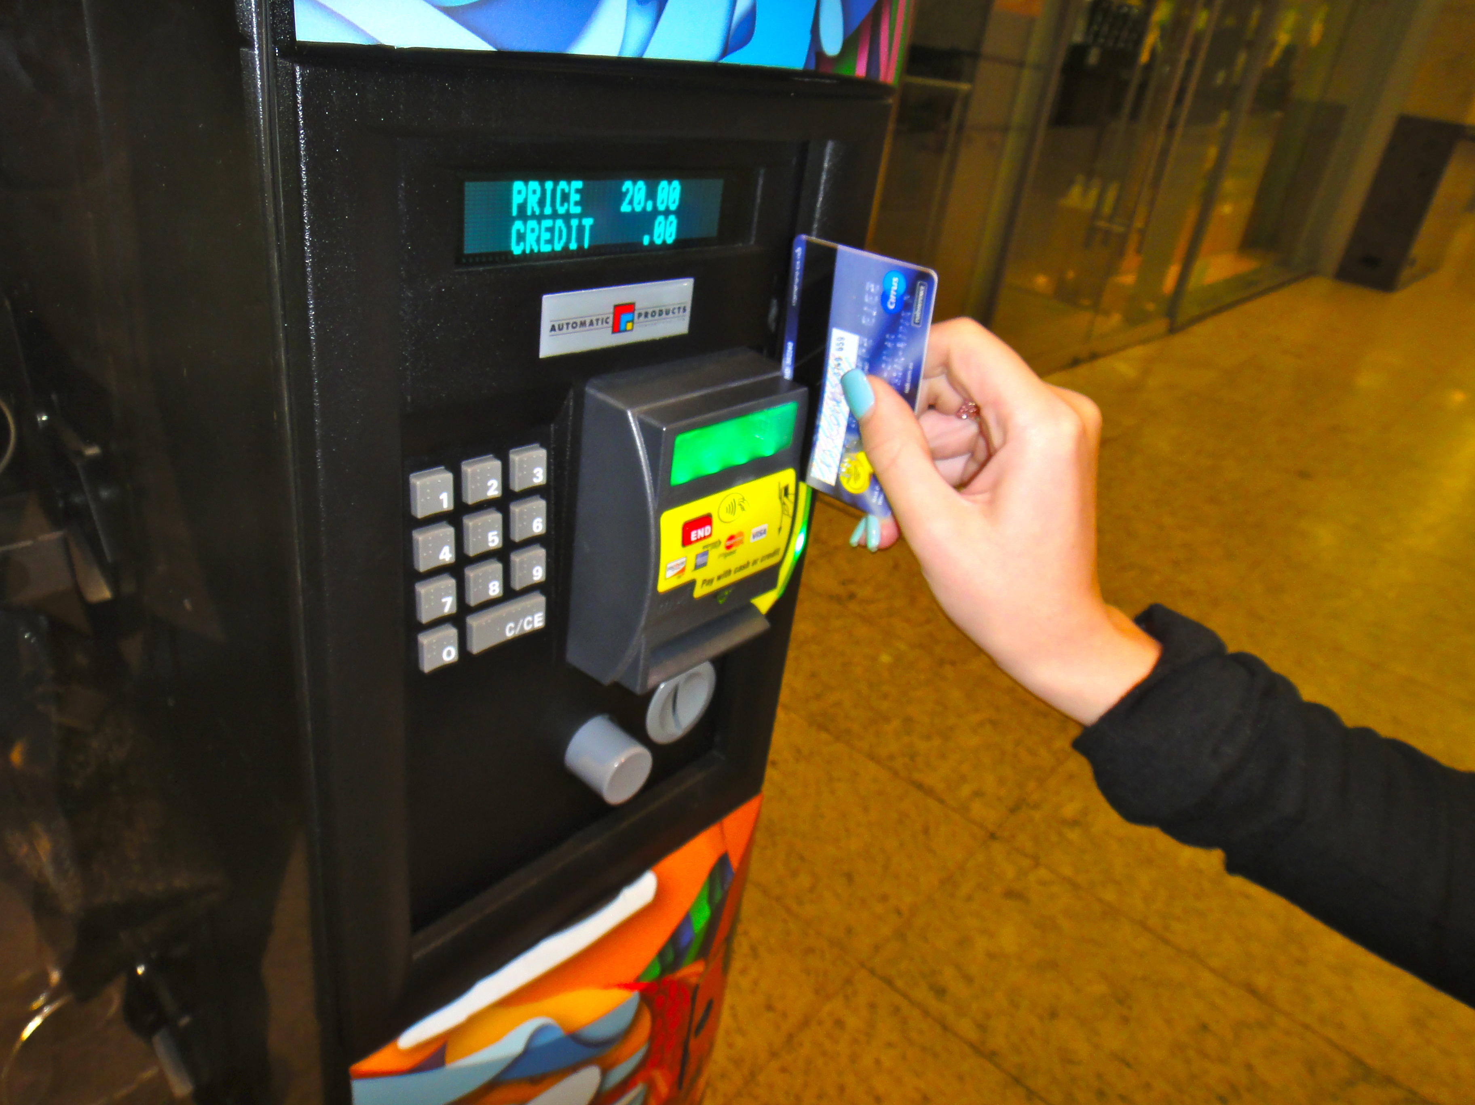
Vending Machine
2
Payment Method Selection

Slide 6
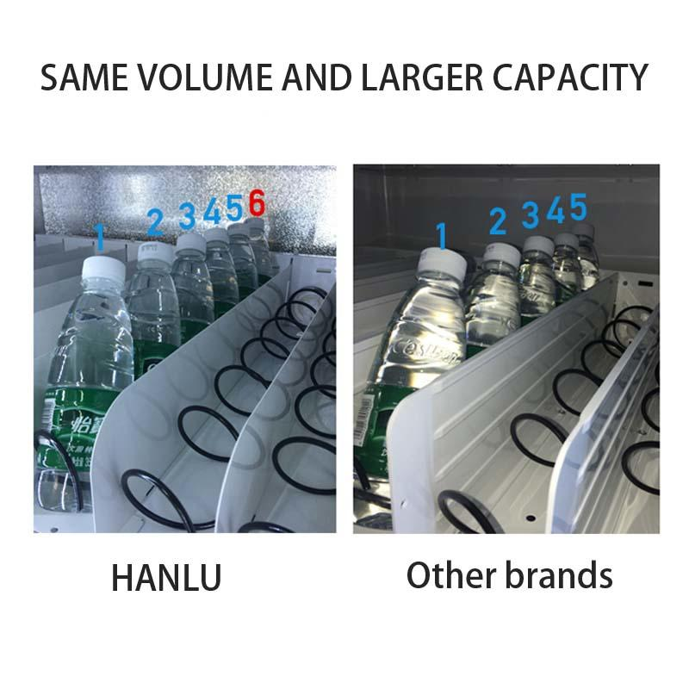
Vending Machine
2
Product Delivery To The User

Slide 7
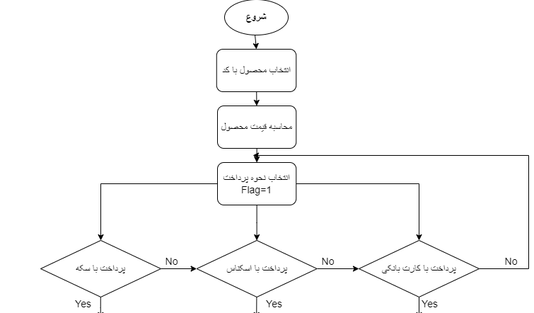
Vending Machine
2
System Primary Flowchart

Slide 8
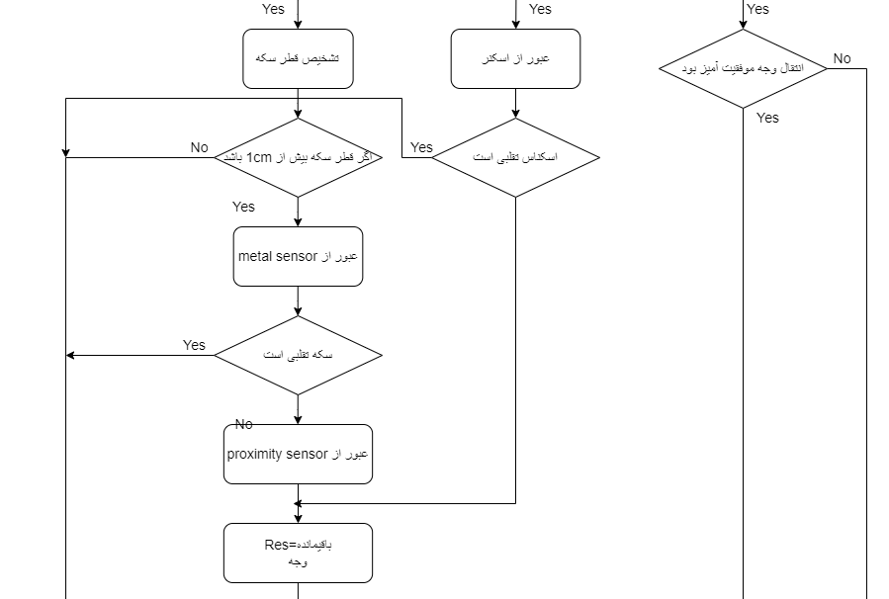
Vending Machine
2
System Primary Flowchart

Slide 9
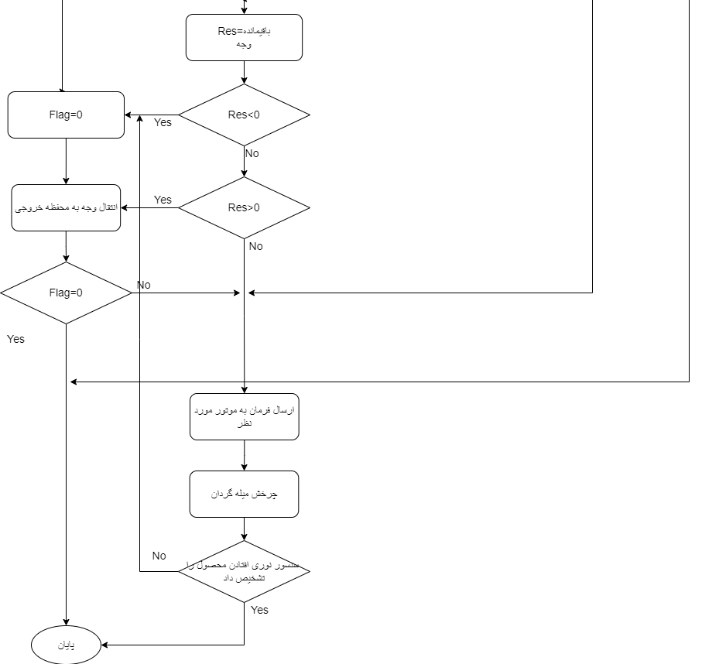
Vending Machine
2
System Primary Flowchart

Slide 10
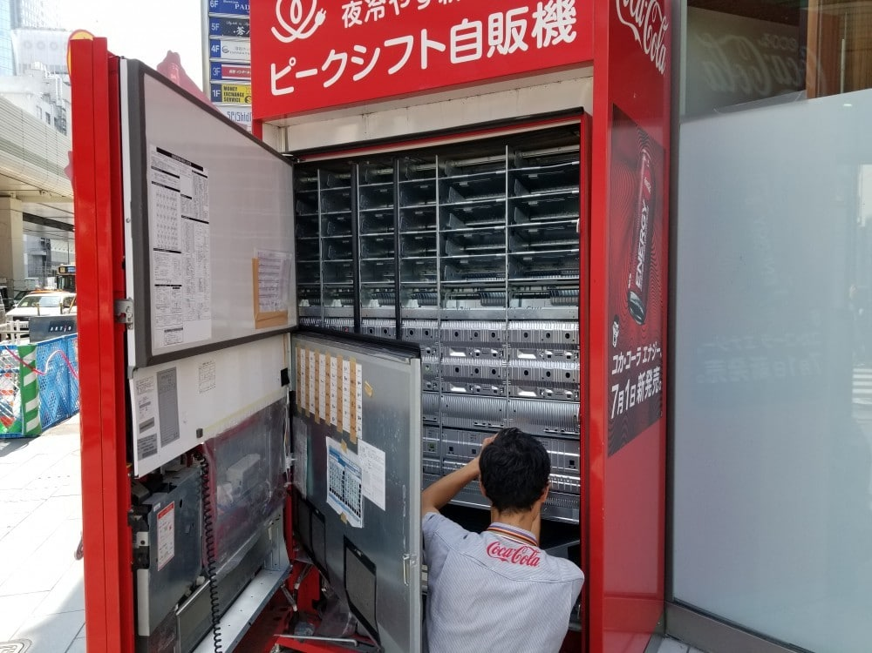
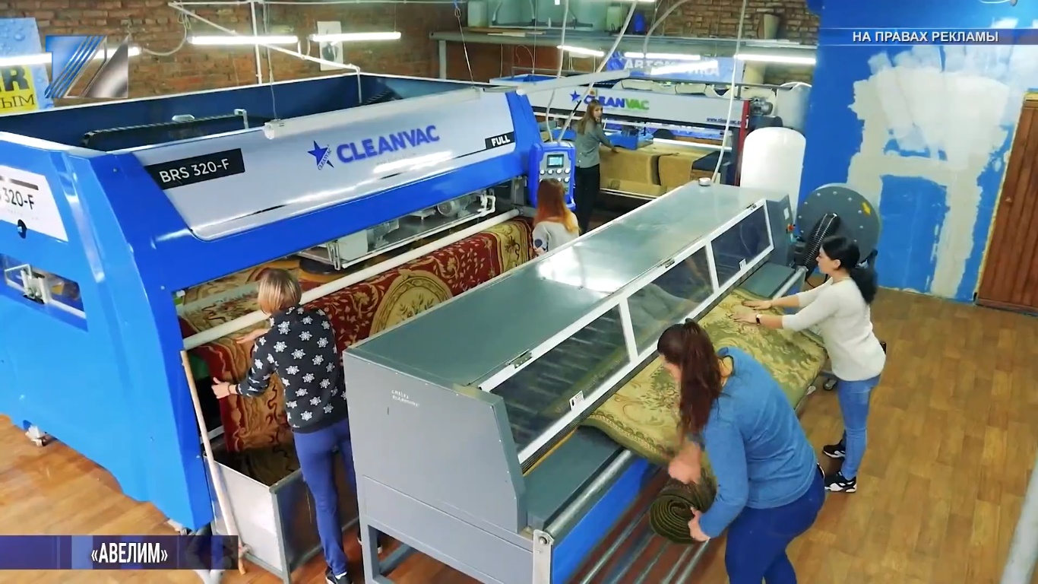
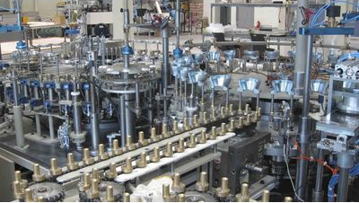
Vending Machine
2
Manual or Automatic?!?!

Slide 11
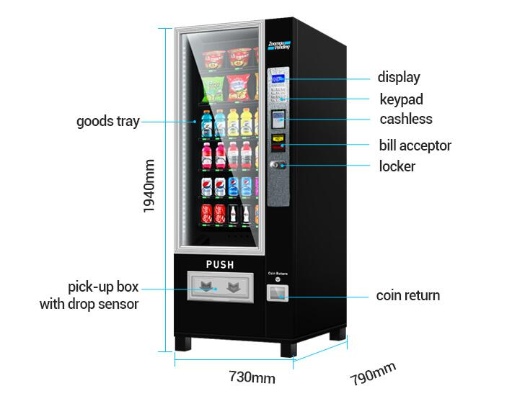

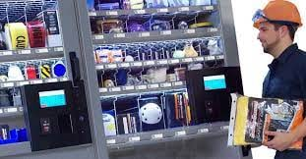
Vending Machine
2
Safety Tips Required

Slide 12

Vending Machine
2
System Disturbances

Slide 13
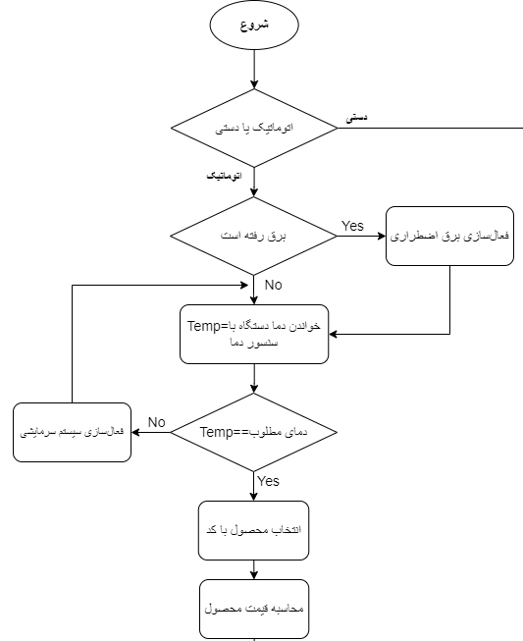
Vending Machine
2
System Secondary Flowchart

Slide 14
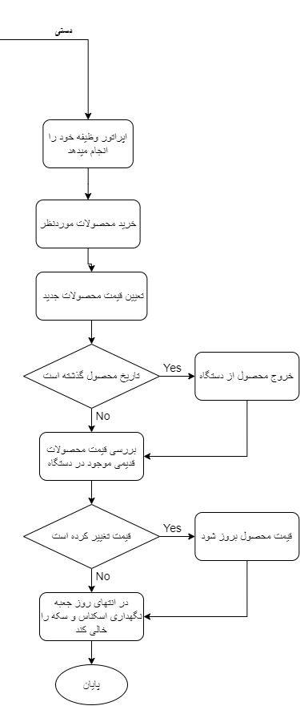
Vending Machine
2
System Secondary Flowchart

Slide 15
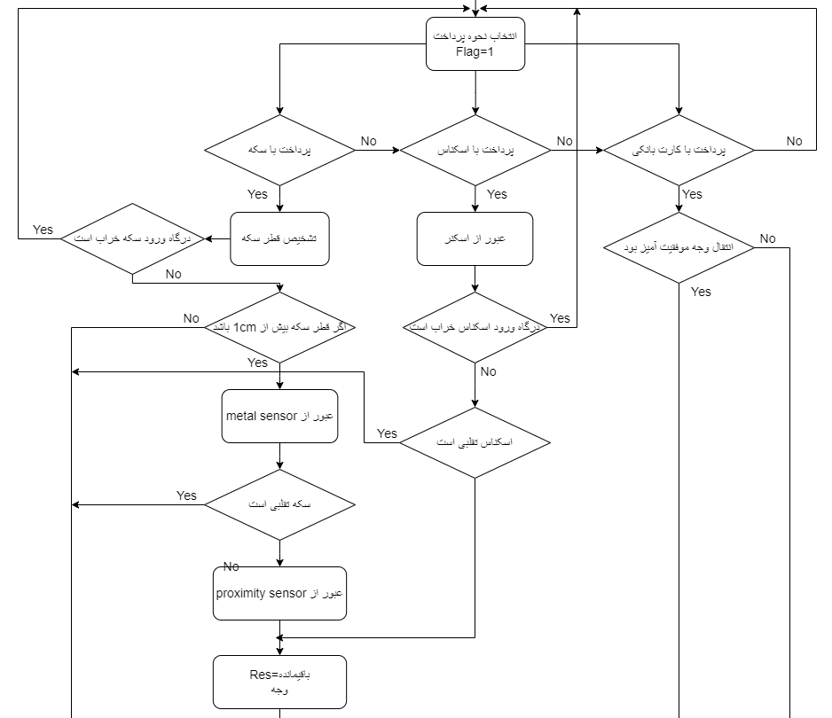
Vending Machine
2
System Secondary Flowchart

Slide 16
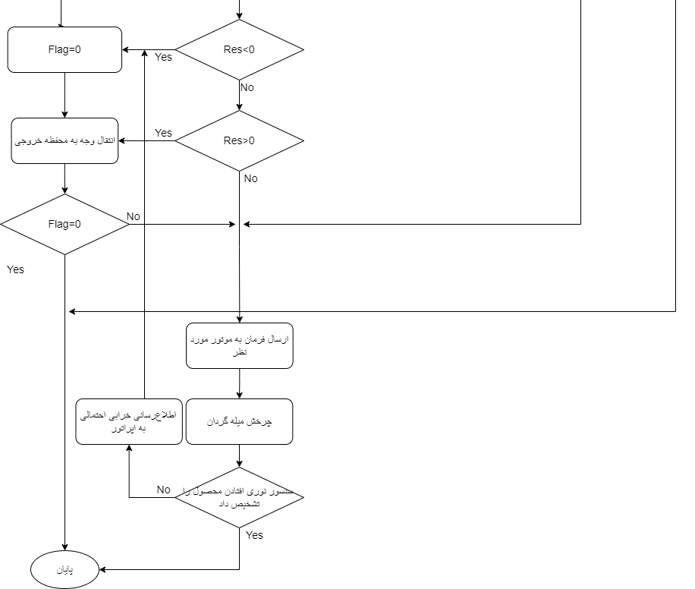
Vending Machine
2
System Secondary Flowchart

Slide 17
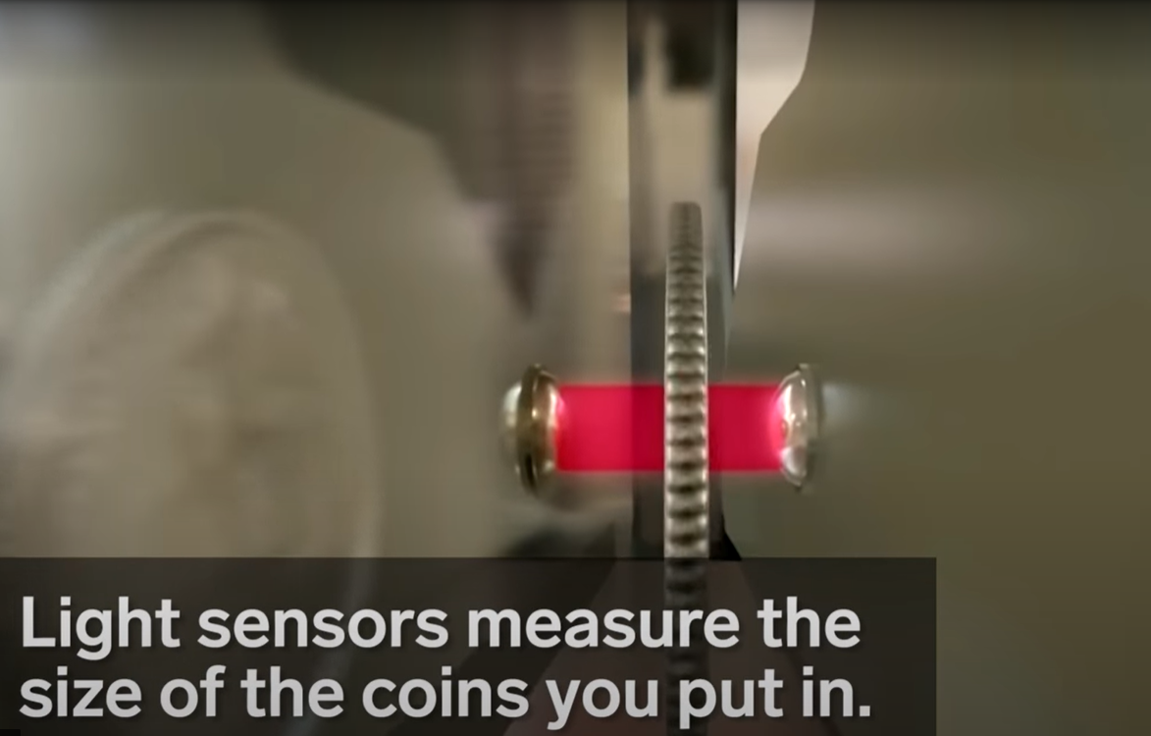
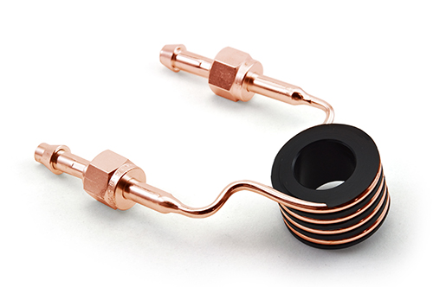
Vending Machine
2
Sensors & Actuators
RF Coil(Metal Detector)
Light Sensor

Slide 18
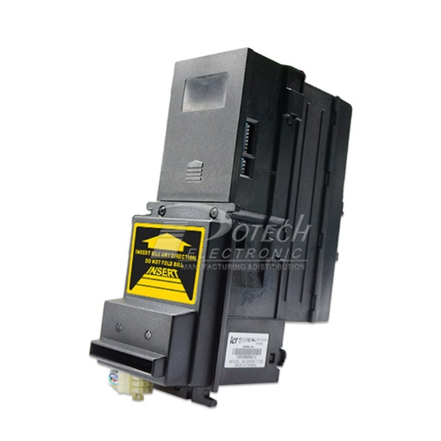
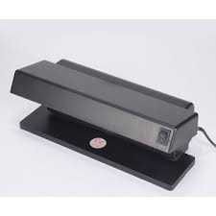
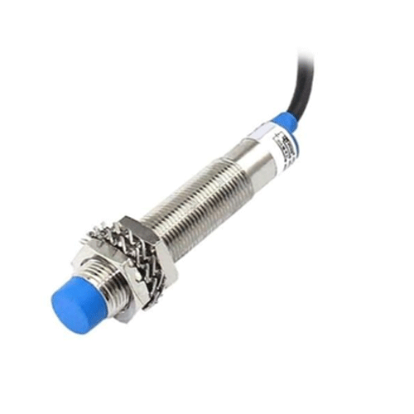
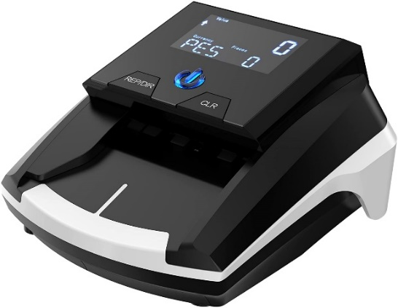
Vending Machine
2
Sensors & Actuators
Proximity Sensor
Metal Detector Or Ultraviolet

Slide 19
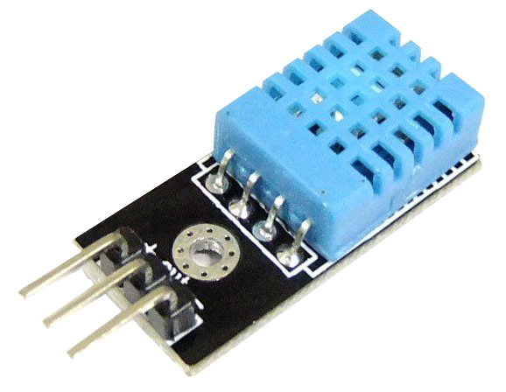
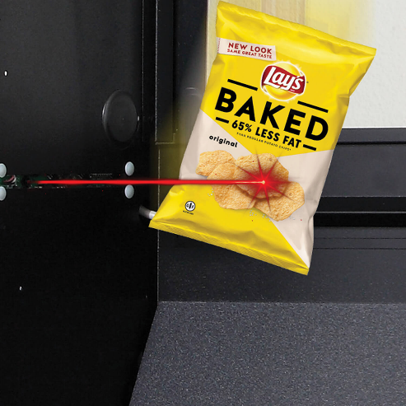
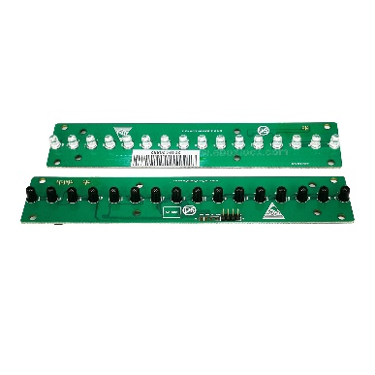
Vending Machine
2
Sensors & Actuators
Light Sensor
Temperature Sensor

Slide 20
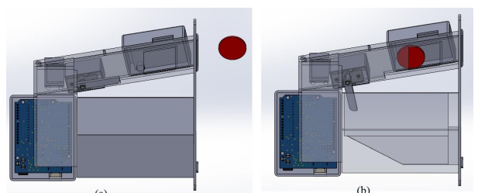
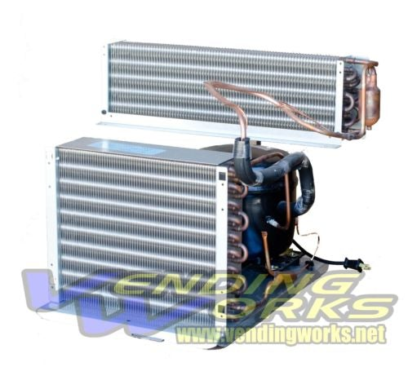
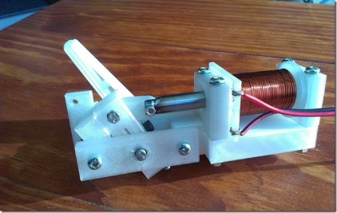
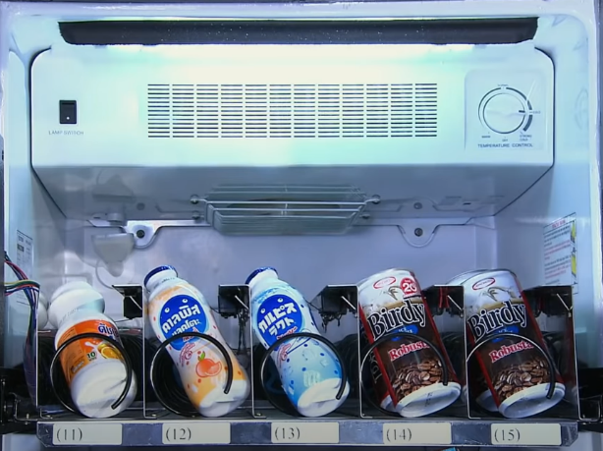
Vending Machine
2
Sensors & Actuators
Flipper
Cooling System

Slide 21
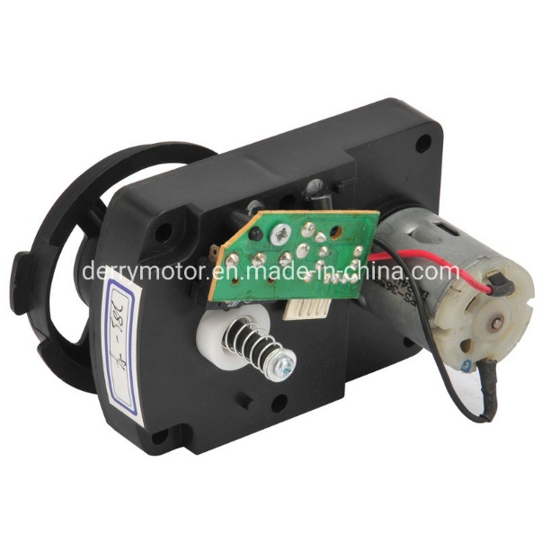
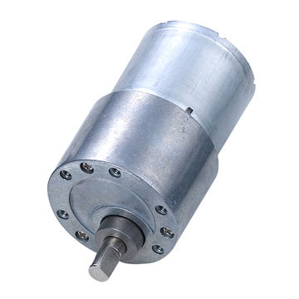
Vending Machine
2
Sensors & Actuators
DC Motor

Slide 22
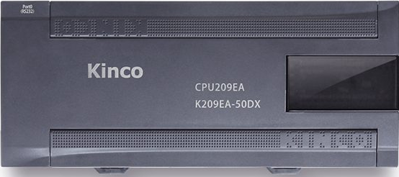
Vending Machine
2
which plc ??

Slide 23
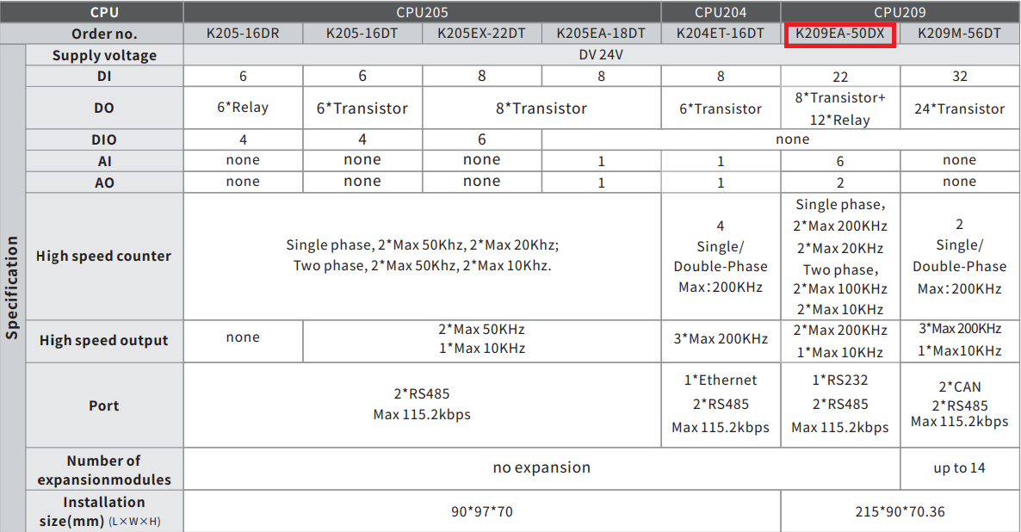
Vending Machine
2
which plc ??

Slide 24
Vending Machine
2
Input&Output

Slide 25
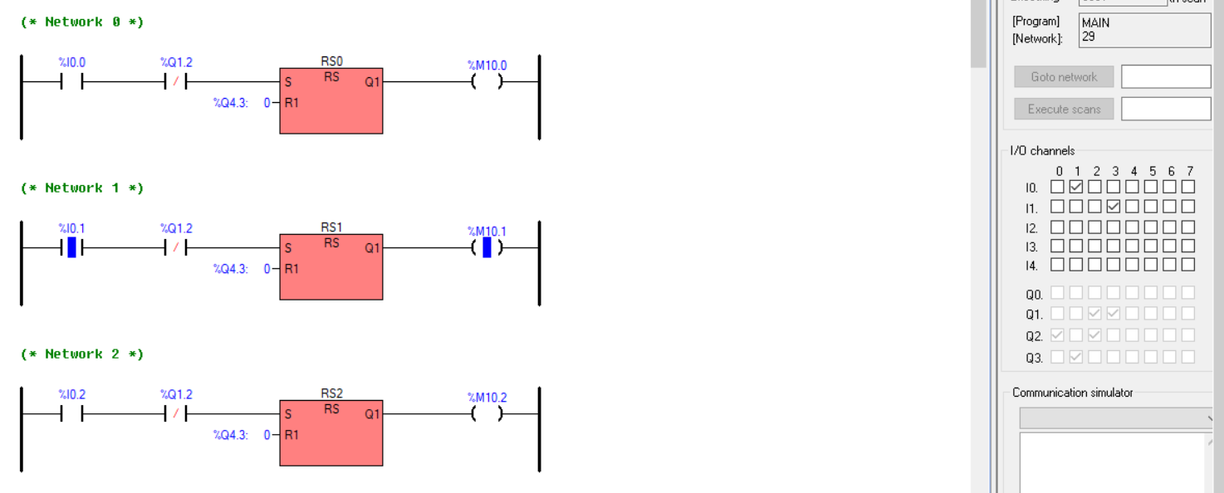
Vending Machine
2
ladder programming

Slide 26

Industrial Cold storage
3
What is cold storage room ?
Applications

Slide 27
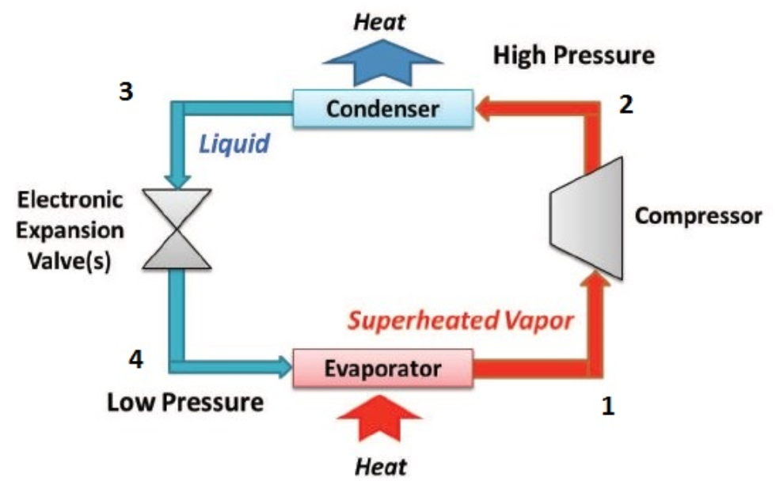
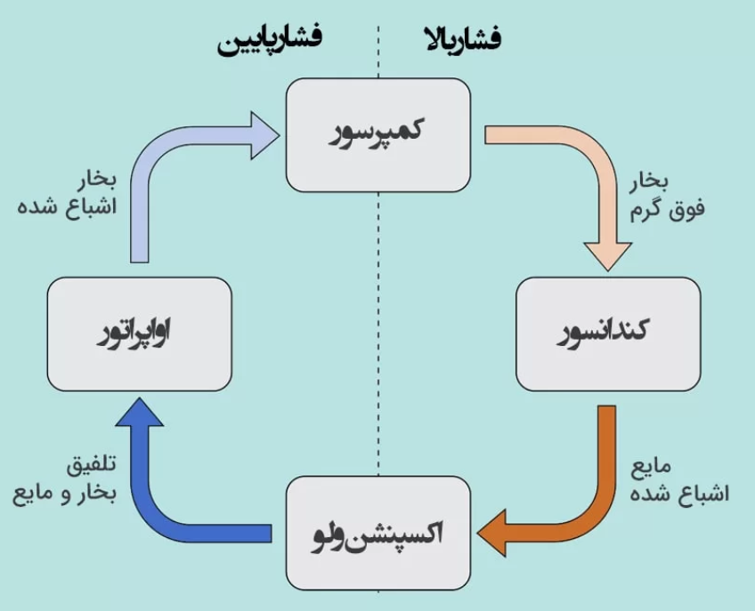
performance of Refrigeration system
3
4 main module: Compressor, Condenser, Expansion Valve, Evaporator

Slide 28
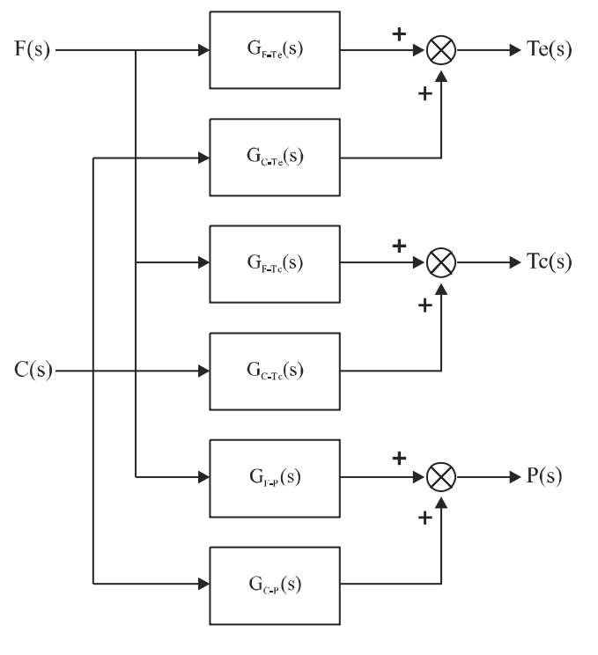
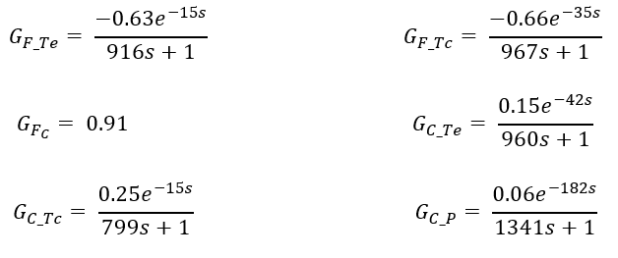
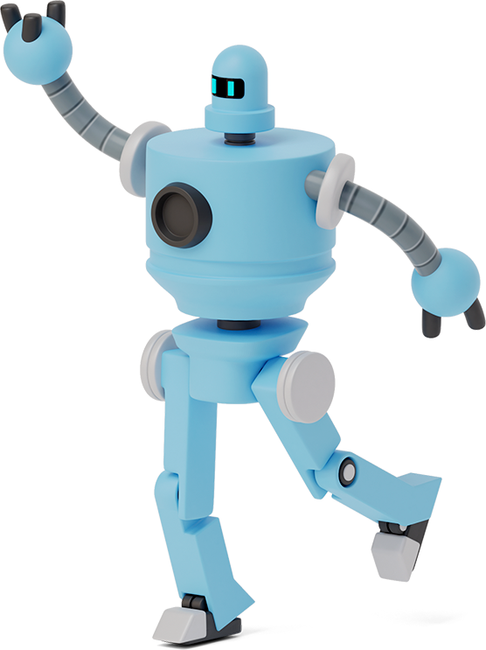
moDELING
3

Slide 29
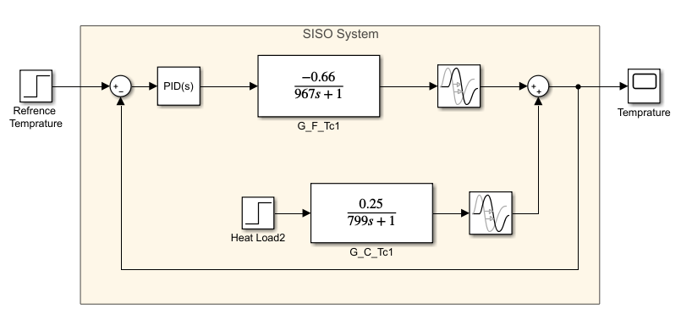
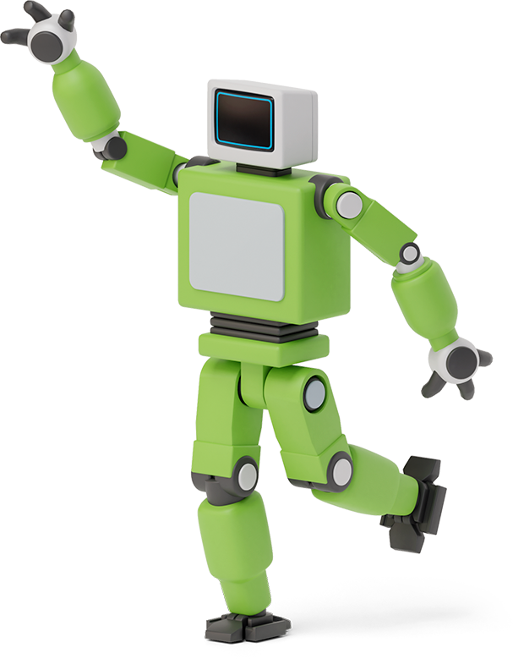

PID CONTROLLER
3
We assumed our system SISO which purposed to control temperature of center of the room
Also we consider heat load(second input) as a disturbance

Slide 30
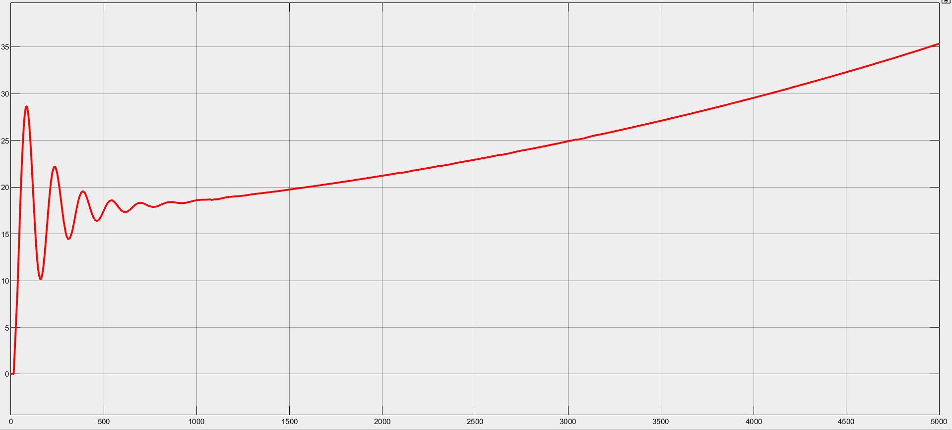
PID CONTROLLER
3
As you see our PID controller can’t stabilize system

Slide 31
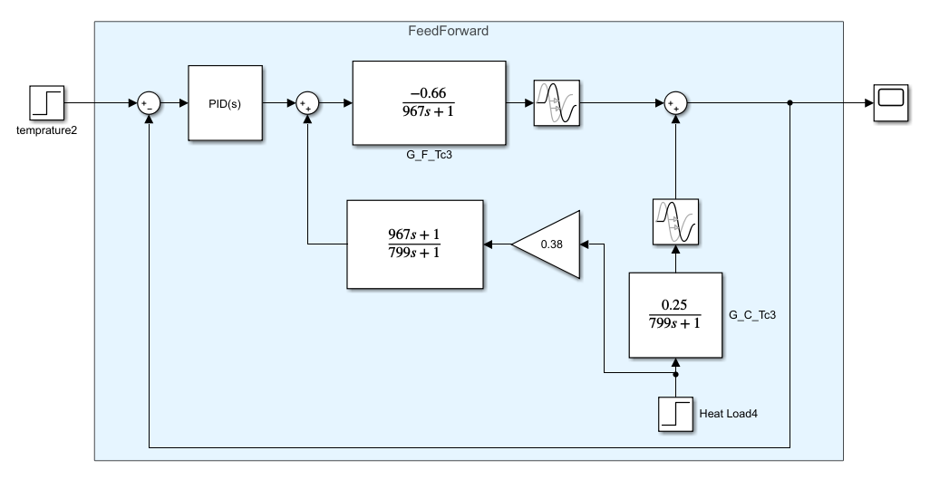

PID CONTROLLER
$g_{ff}=\frac{−g_{d}}{g}=\frac{0.38∗(967s+1)}{799s+1}$
We ignored delay term because of causality
3

Slide 32

feedforward CONTROLLER
3
As you see our Feedback\Forward controller can stabilize system output and reduce disturbance effects

Slide 33

LADDER DIAGRAM

Slide 34

LADDER DIAGRAM

Slide 35

LADDER DIAGRAM

Slide 36

LADDER DIAGRAM

Slide 37

LADDER DIAGRAM

Slide 38
Any questions?
Thanks!

